Slide 1
Problem Solving and Search
Lesson 4

Slide 2
Outline
Problem-solving agents
Problem types
Problem formulation
Example problems
Basic search algorithms

Slide 3
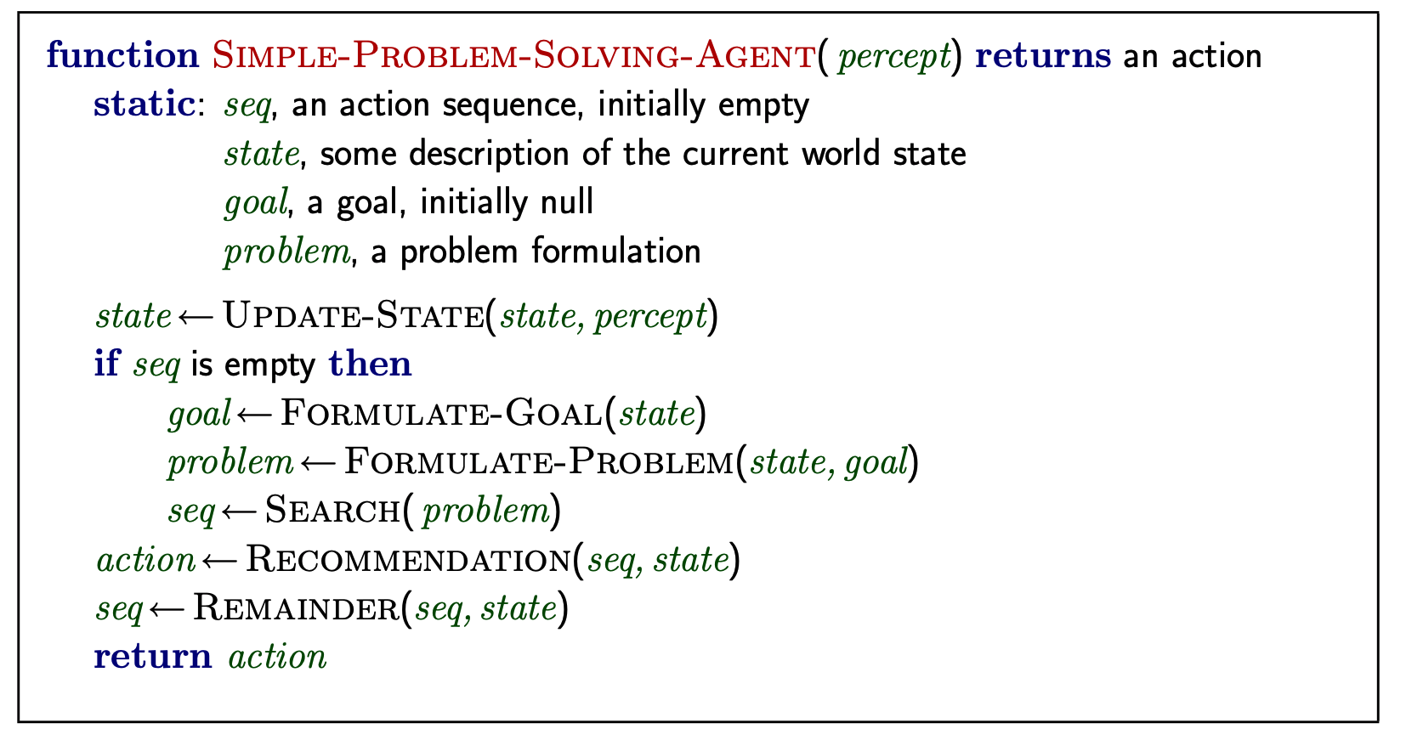
Problem-solving agents
Restricted form of general agent:
Note: this is offline problem solving; solution executed “eyes closed”
Online problem solving involves acting without complete knowledge.

Slide 4
Example: Romania
On holiday in Romania; currently in Arad.
Flight leaves tomorrow from Bucharest
Formulate goal:
Be in Bucharest
Formulate problem:
States: various cities
Actions: drive between cities
Find solution:
Sequence of cities, e.g., Arad, Sibiu, Fagaras, Bucharest.

Slide 5
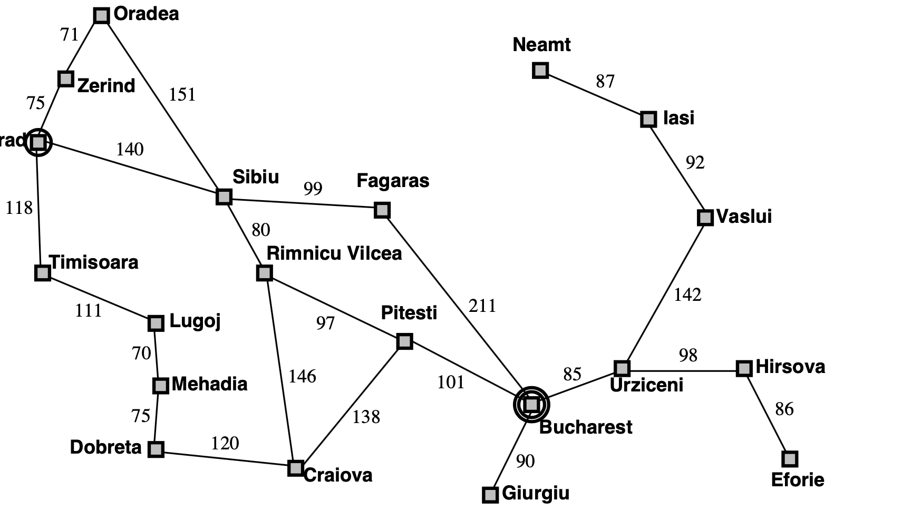
Example: Romania

Slide 6
Problem types
Deterministic, fully observable single-state problem
Agent knows exactly which state it will be in; solution is a sequence
Non-observable conformant problem
Agent may have no idea where it is; solution (if any) is a sequence
Nondeterministic and / or partially observable contingency problem
Percepts provide new information about current state
Solution is a contingent plan or a policy
Often interleave search, execution
Unknown state space exploration (“online”)

Slide 7
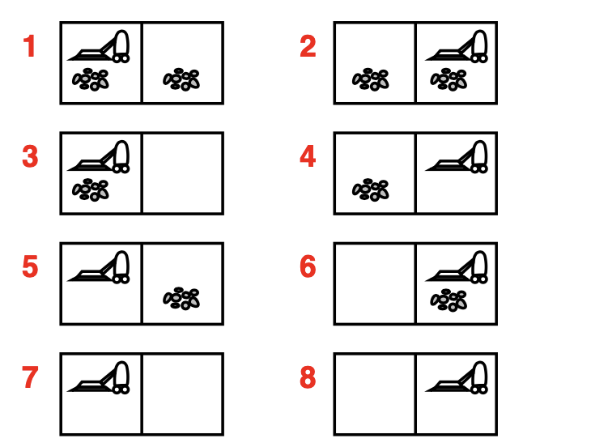
Single-state, start #5. Solution?
[Right, Suck]
Conformant, start in {1, 2, 3, 4, 5, 6, 7, 8}
e.g., Right goes to {2,4,6,8}. Solution?
[Right, Suck, Left, Suck]
Contingency, start in #5
Murphy's Law: Suck can dirty a clean carpet
Local sensing: dirt, location only.
Solution?
[Right, if dirt then Suck]

Slide 8
Single-state problem formulation
A problem is defined by four items:
Initial state e.g., “at Arad”
Successor function S(x) = set of action-state pairs e.g., S(Arad) = {⟨ Arad → Zerind, Zerind⟩,…}
Goal test, can be
Explicit, e.g., x = “at Bucharest”
Implicit, e.g., NoDirt(x)
Path cost (additive)
E.g., sum of distances, number of actions executed, etc.
c(x, a, y) is the step cost, assumed to be ≥ 0
A solution is a sequence of actions
Leading from the initial state to a goal state

Slide 9
Selecting a state space
Real world is absurdly complex
state space must be abstracted for problem solving
(Abstract) state = set of real states
(Abstract) action = complex combination of real actions
e.g., “Arad → Zerind” represents a complex set of possible routes, detours, rest stops etc.
For guaranteed realisability, any real state “in Arad” must get to some real state “in Zerind”
(Abstract) solution =
Set of real paths that are solutions in the real world
Each abstract action should be “easier” than the original problem!

Slide 10
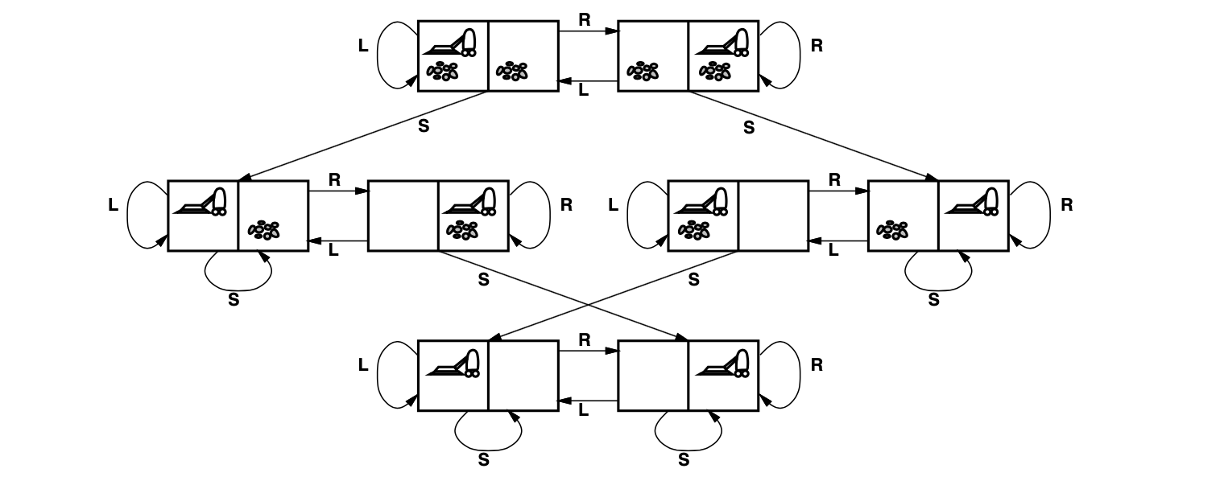
Example: vacuum world state space graph
States? Integer dirt and robot locations (ignore dirt amounts etc.)
Actions? Left, Right, Suck, NoOp
Goal test? No dirt
Path cost? 1 per actions (0 for NoOp)

Slide 11
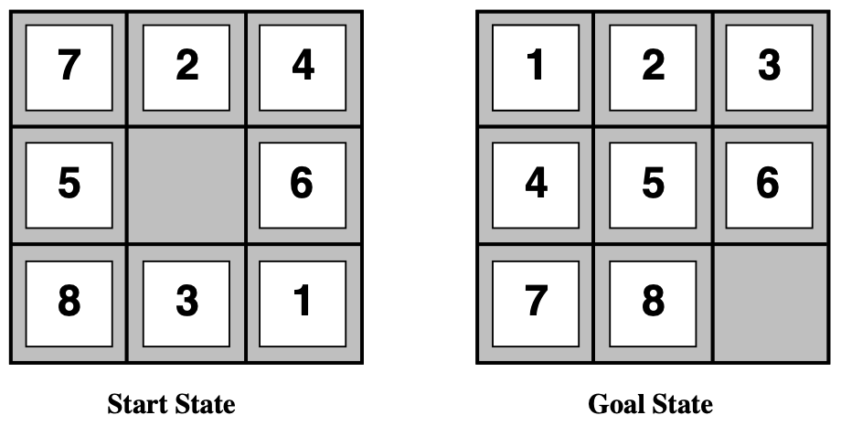
Example: The 8-puzzle
States? Integer location of tiles (ignore intermediate positions)
Actions? Move blank left, right, up, down (ignore unjamming etc.)
Goal test? Goal state (given)
Path cost? 1 per move
[Note: optimal solution of n-Puzzle family is NP-hard]

Slide 12
Example: robotic assembly
States? Real-valued coordinates of robot joint angles parts of the object to be assembled
Actions? Continuous motions of robot joins
Goal test? Complete assembly with no robot included!
Path cost? Time to execute.

Slide 13
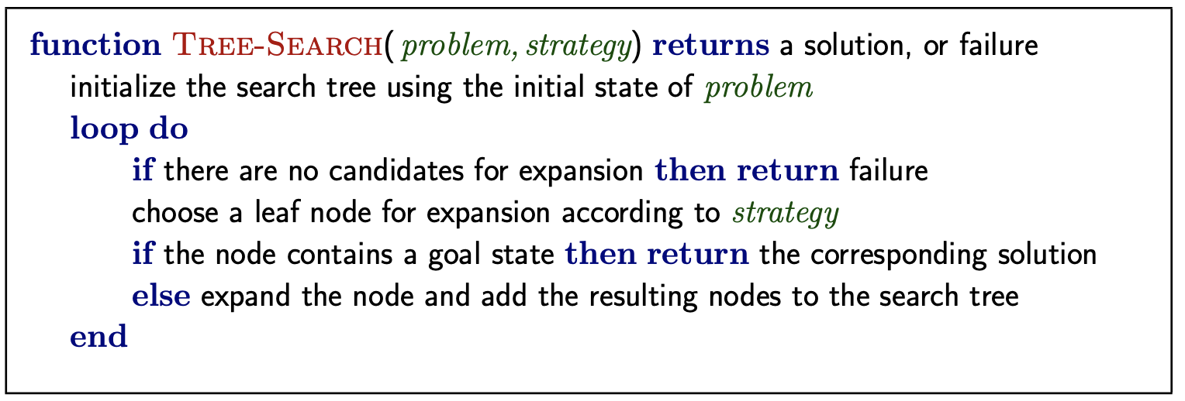
Tree search algorithms
Basic idea:
Offline, simulated exploration of state space by generating successors of already-explored states (a.k.a expanding states)

Slide 14
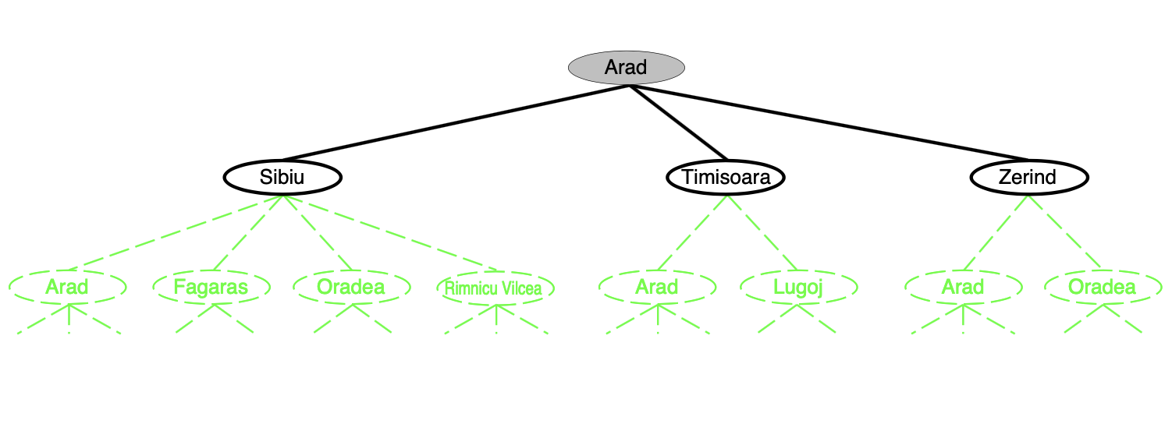
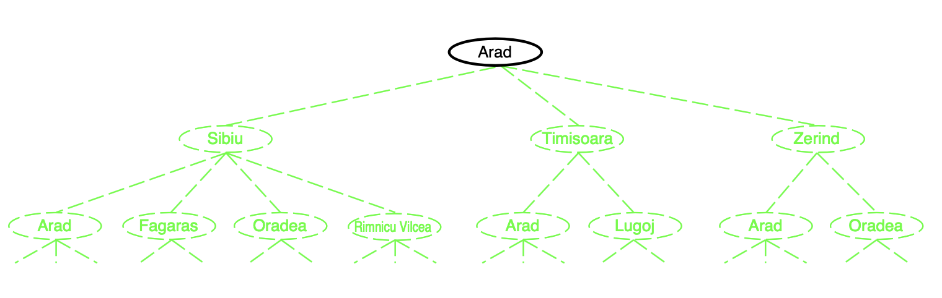
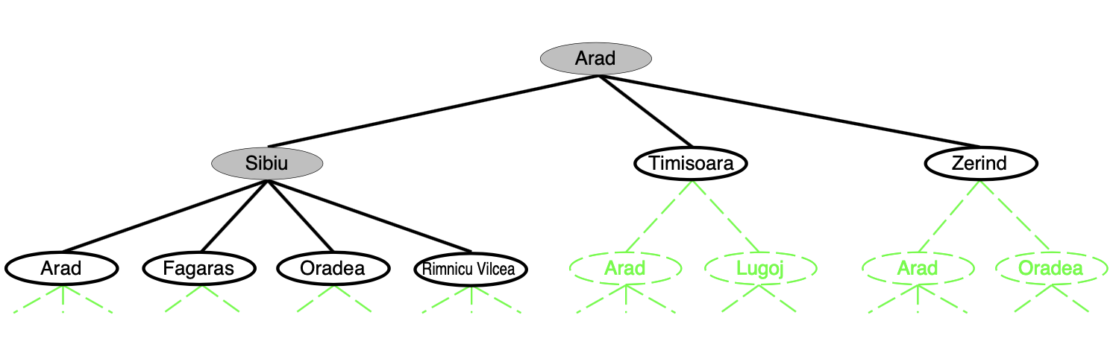
Tree search example

Slide 15
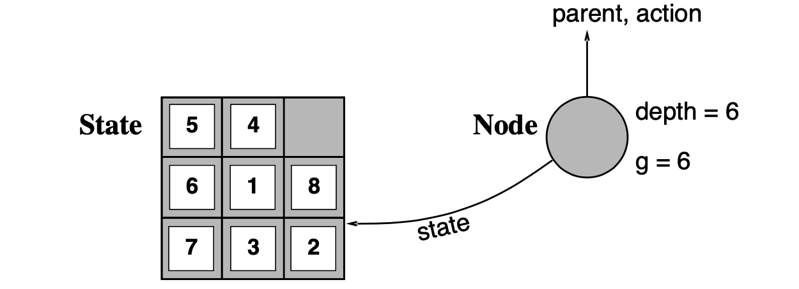
Implementation: states vs. nodes
A state is a representation of a psychical configuration
A node is a data structure constituting part of a search tree
Includes parent, children, depth, path cost g(x)
States do not have parents, children, depth, or path cost!
The expanse function creates new nodes, filling in the various fields and using the successorFn of the problem to create the corresponding states.

Slide 16
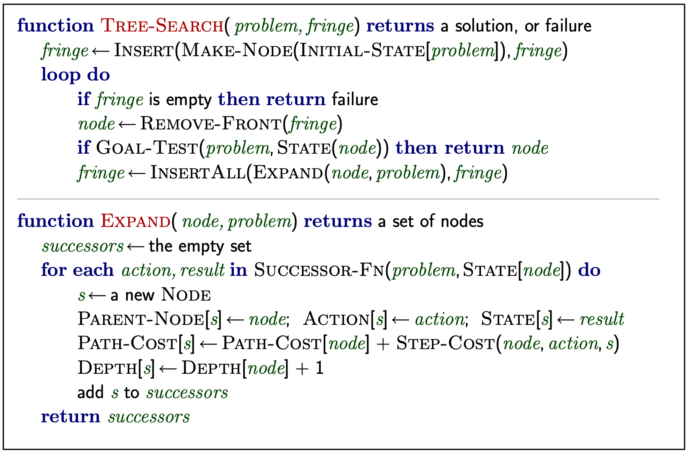
Implementation: general tree search

Slide 17
Search strategies
A strategy is defined by picking the order of node expansion
Strategies are evaluated along the following dimensions:
Completeness — does it always find a solution if one exists?
Time complexity — number of nodes generated / expanded
Space complexity — maximum number of nodes in memory
Optimality — does it always find a least-cost solution?
Time and space complexity are measured in terms of
b — maximum branching factor of the search tree
d — depth of the least-cost solution
m — maximum depth of the state space (may be ∞)

Slide 18
Uniformed search strategies
Uniformed strategies use only the information available in the problem definition
Breadth-first search
Uniform-cost search
Depth-first search
Depth-limited search
Iterative deepening search

Slide 19
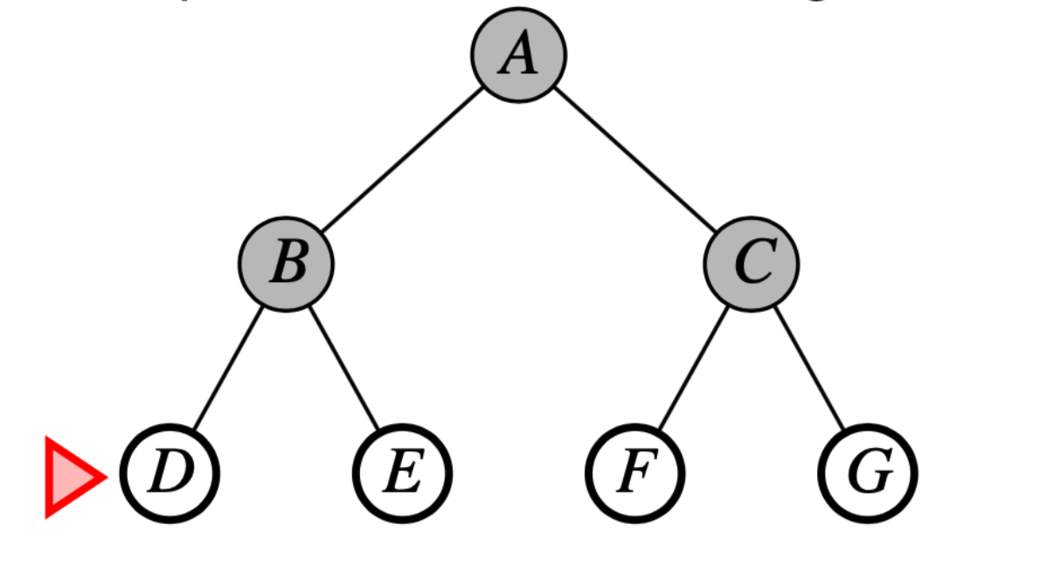
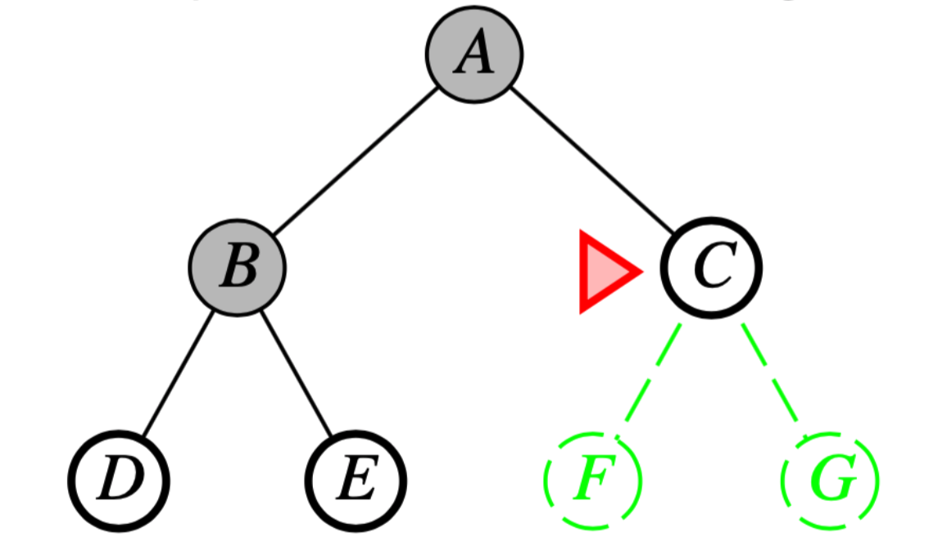
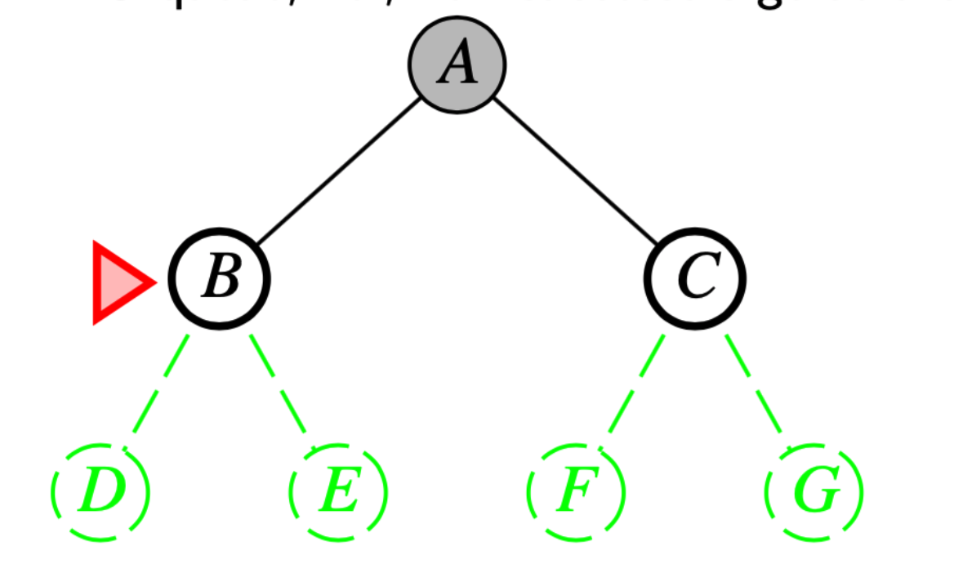
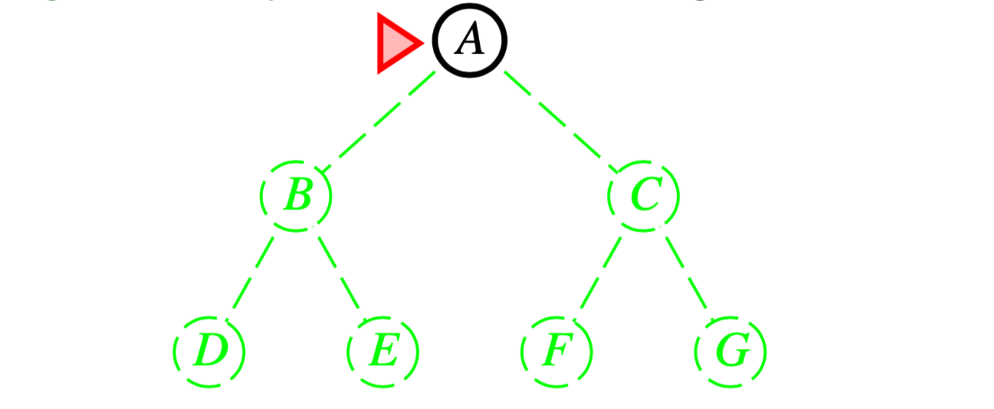
Breadth-first search
Expand shallowest unexpanded node
Implementation:
fringe is a FIFO queue, i.e., new successors go at end

Slide 20
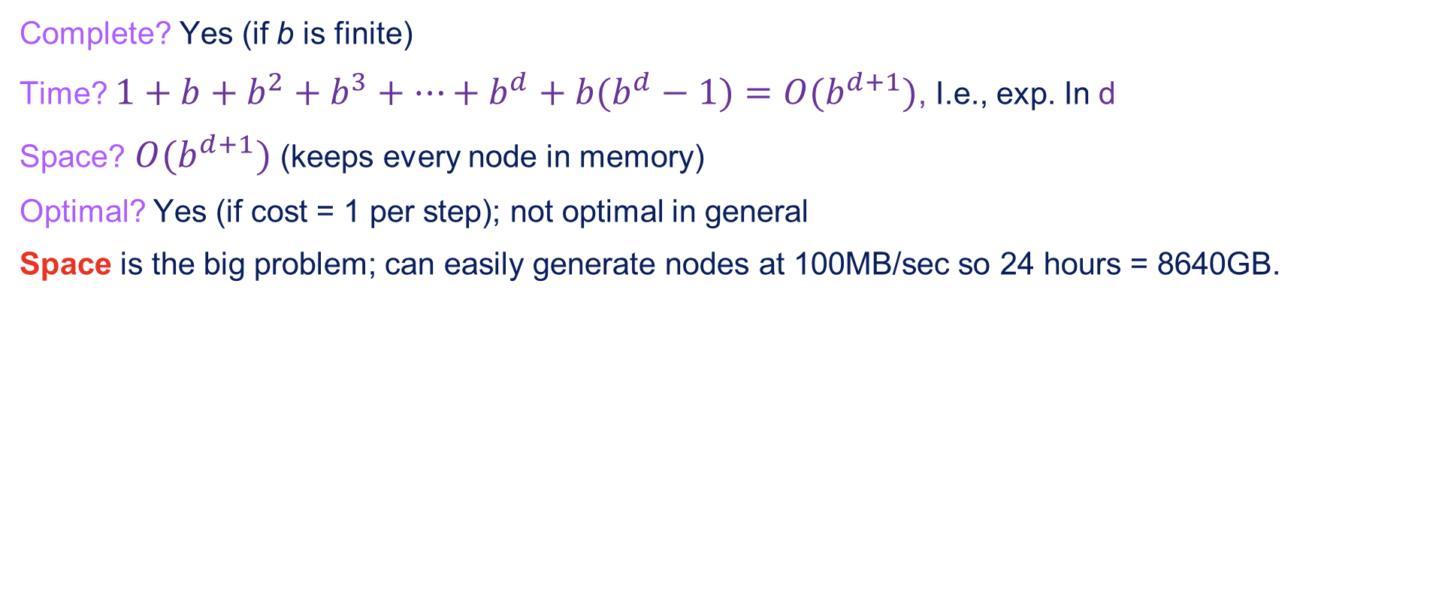
Properties of breadth-first search
Complete? Yes (if b is finite)
Time? $1+b+b^{2}+b^{3}+…+b^{d}+b(b^{d}−1)=O(b^{d+1})$, I.e., exp. In d
Space? $O(b^{d+1})$ (keeps every node in memory)
Optimal? Yes (if cost = 1 per step); not optimal in general
Space is the big problem; can easily generate nodes at 100MB/sec so 24 hours = 8640GB.

Slide 21
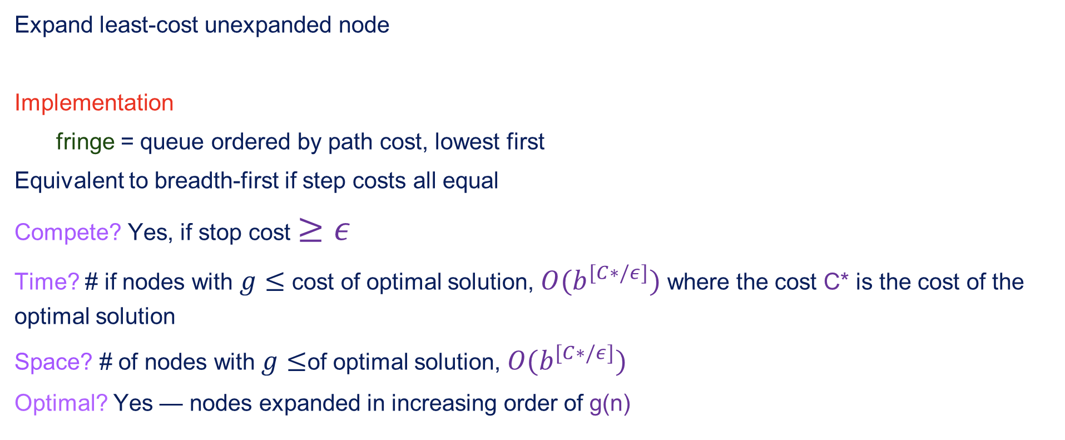
Uniform-cost search
Expand least-cost unexpanded node
Implementation
fringe = queue ordered by path cost, lowest first
Equivalent to breadth-first if step costs all equal
Compete? Yes, if stop cost $≥ε$
Time? # if nodes with $g≤$ cost of optimal solution, $O(b^{[C∗/ε]})$ where the cost C* is the cost of the optimal solution
Space? # of nodes with $g≤$of optimal solution, $O(b^{[C∗/ε]})$
Optimal? Yes — nodes expanded in increasing order of g(n)

Slide 22
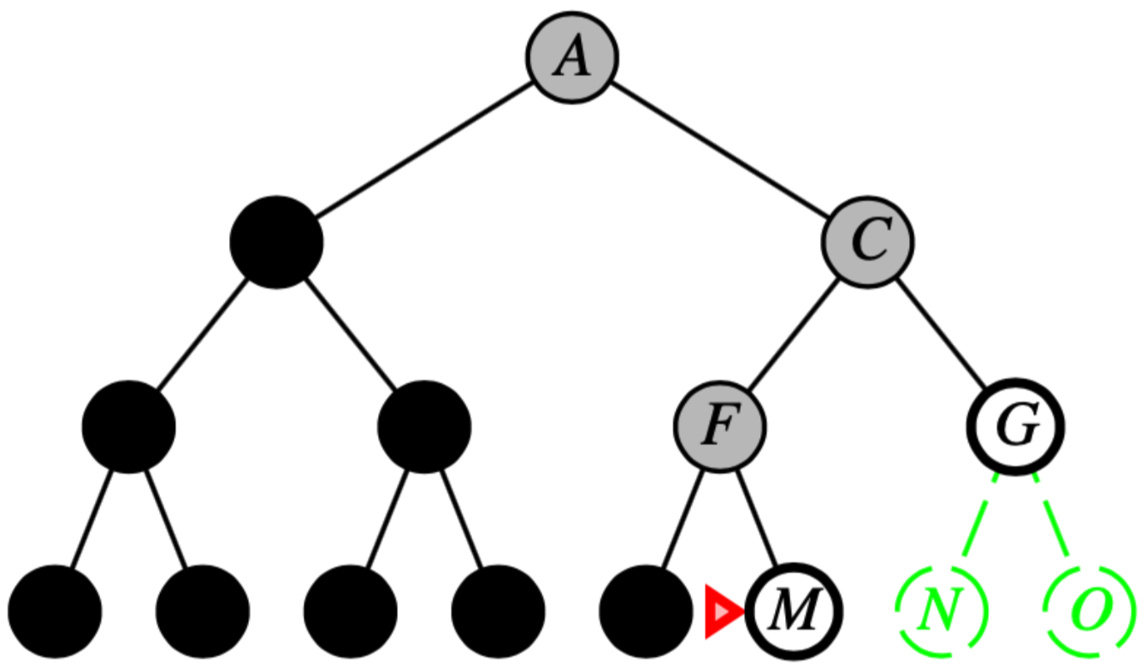
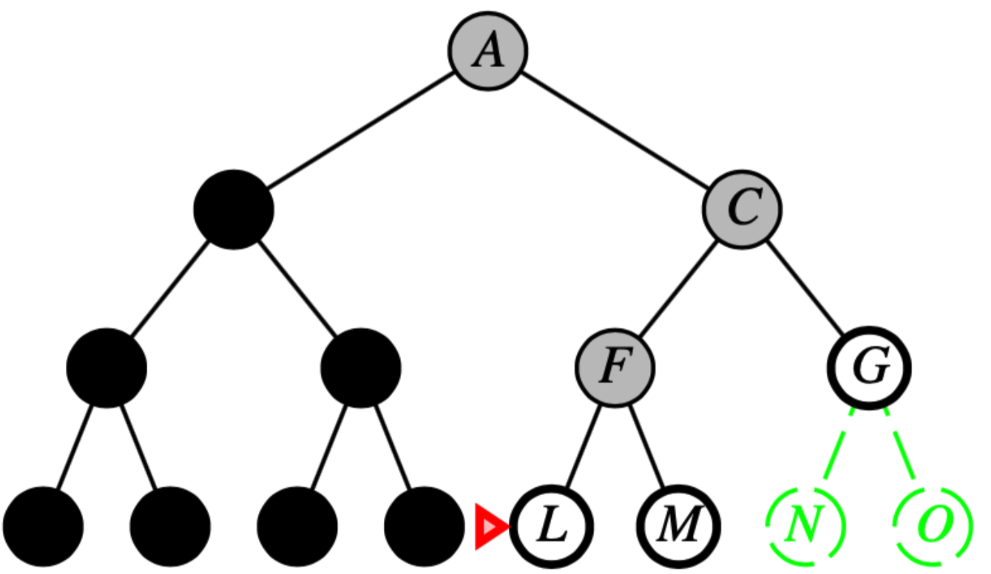
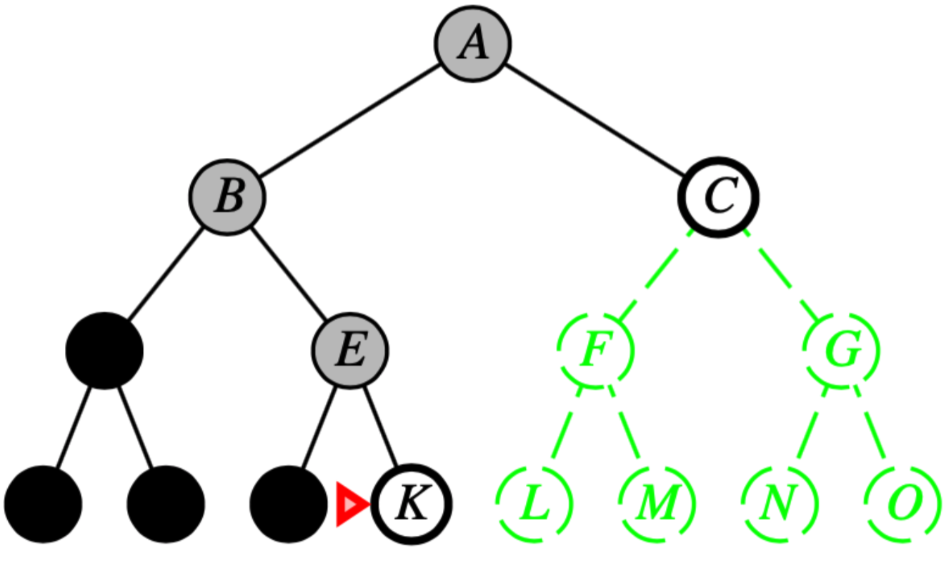
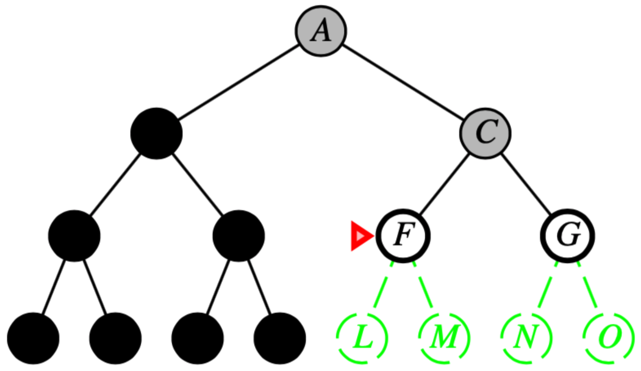
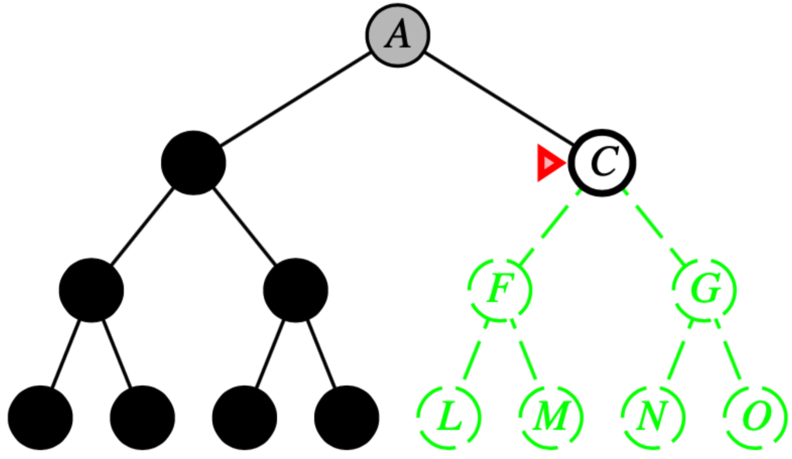
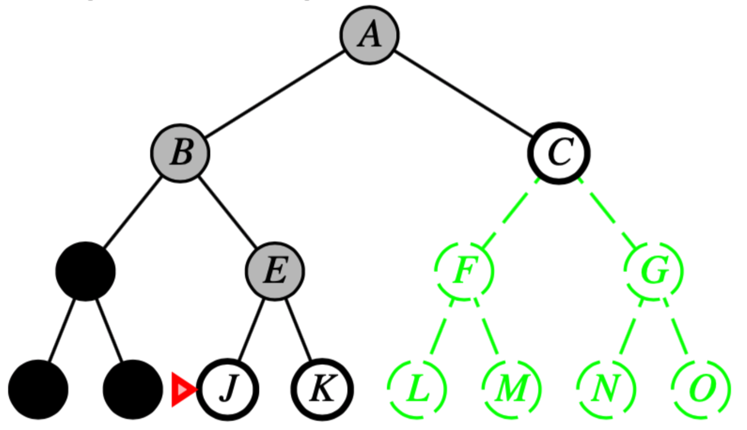
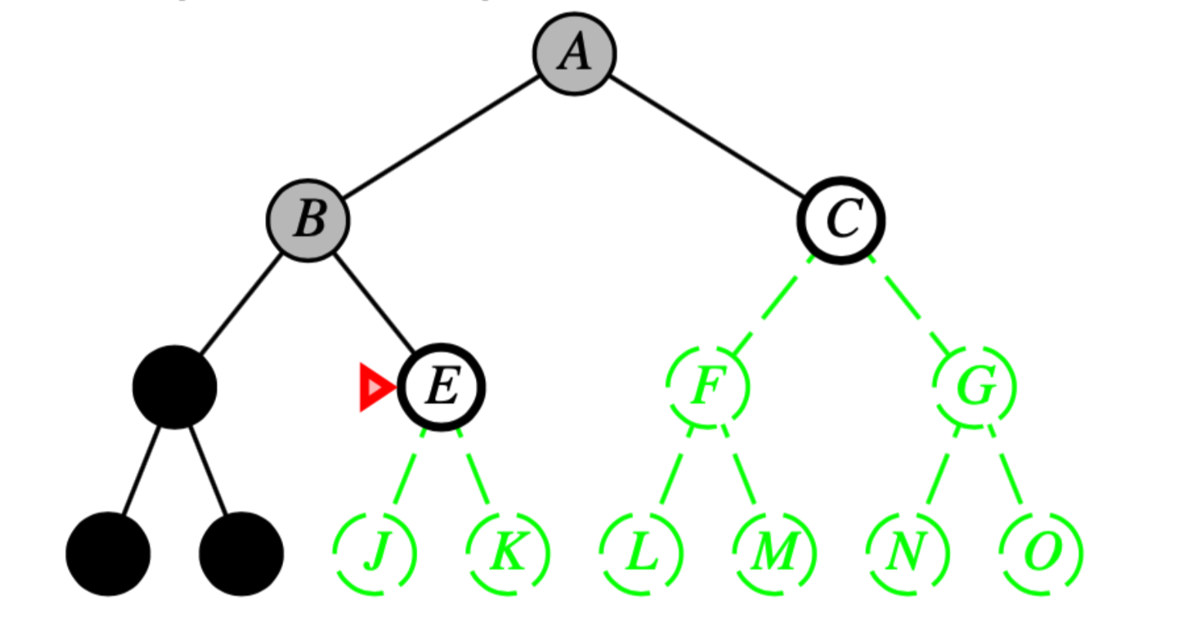
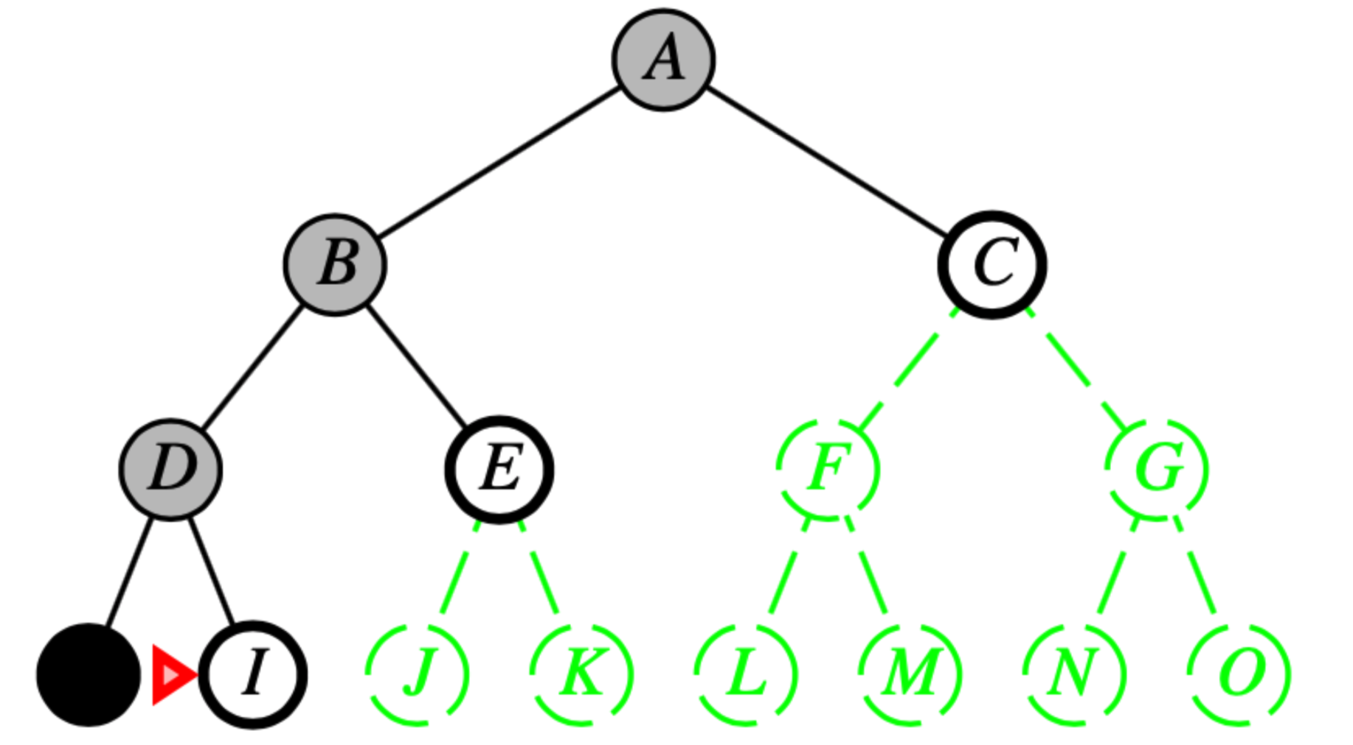
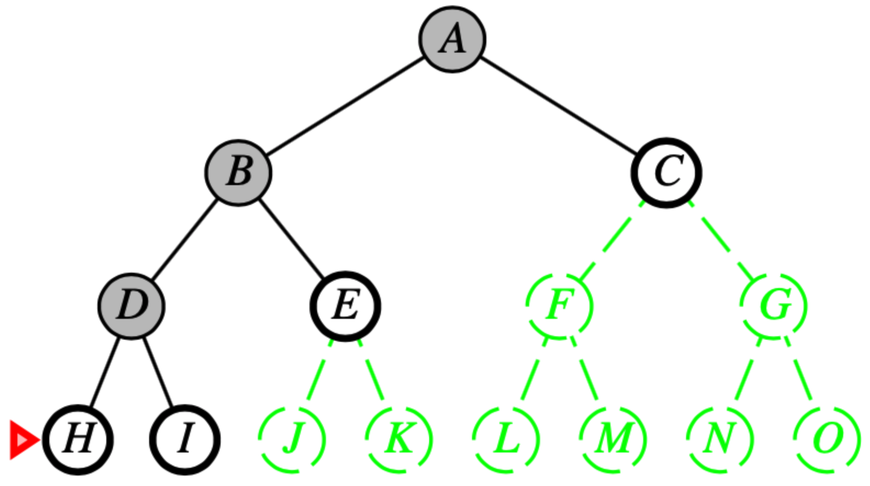
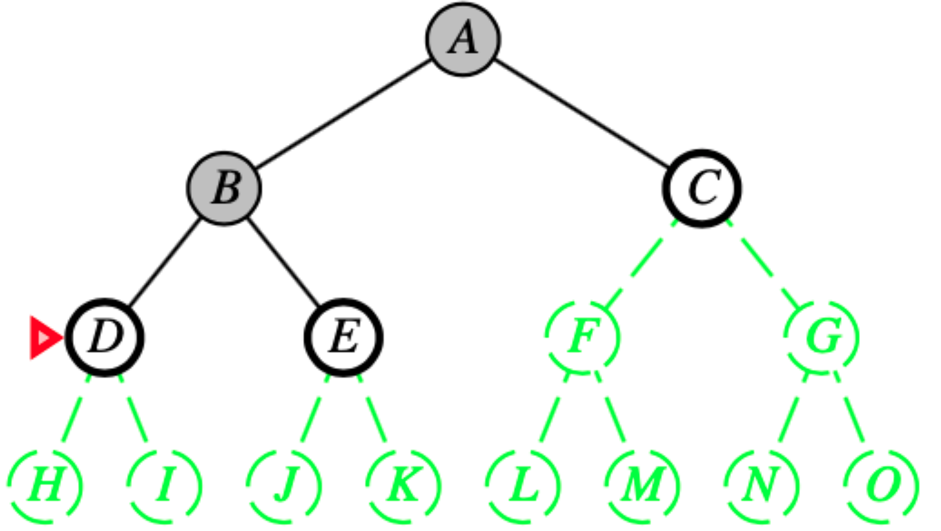
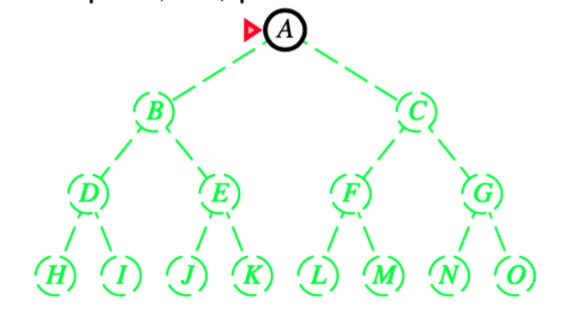
Depth-first search
Expand deepest unexpanded node
Implementation:
fringe = LIFO queue, i.e., put successors at front

Slide 23
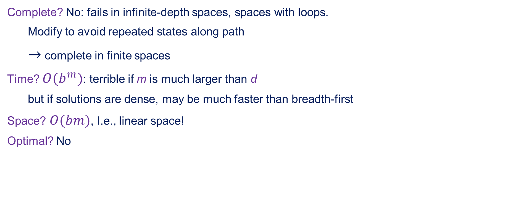
Properties of depth-first search
Complete? No: fails in infinite-depth spaces, spaces with loops.
Modify to avoid repeated states along path
$→$ complete in finite spaces
Time? $O(b^{m})$: terrible if m is much larger than d
but if solutions are dense, may be much faster than breadth-first
Space? $O(bm)$, I.e., linear space!
Optimal? No

Slide 24
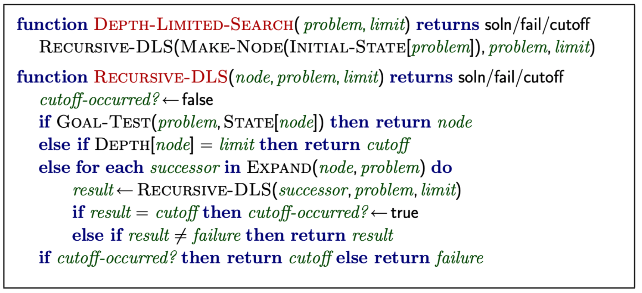
Depth-limited search
= depth-first search with depth limit l,
i.e., nodes at depth l have no successors
Recursive implementation:

Slide 25
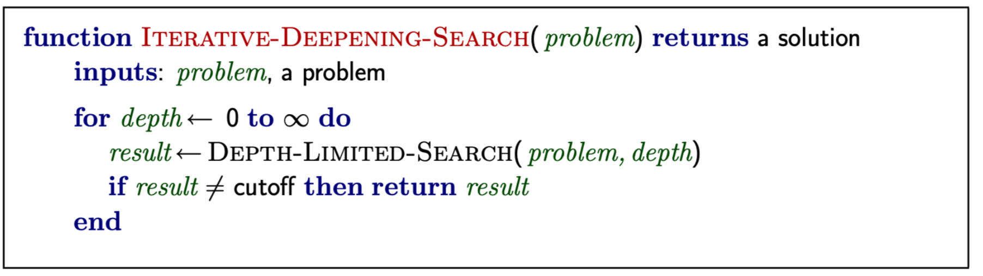
Iterative deepening search

Slide 26
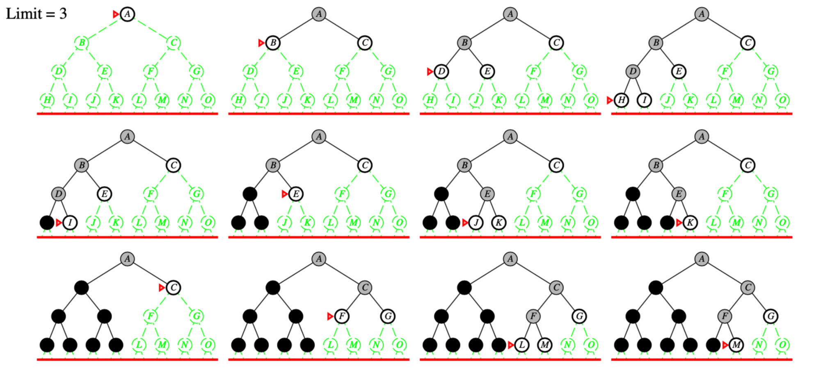
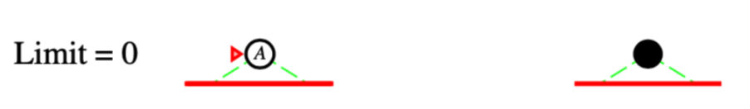
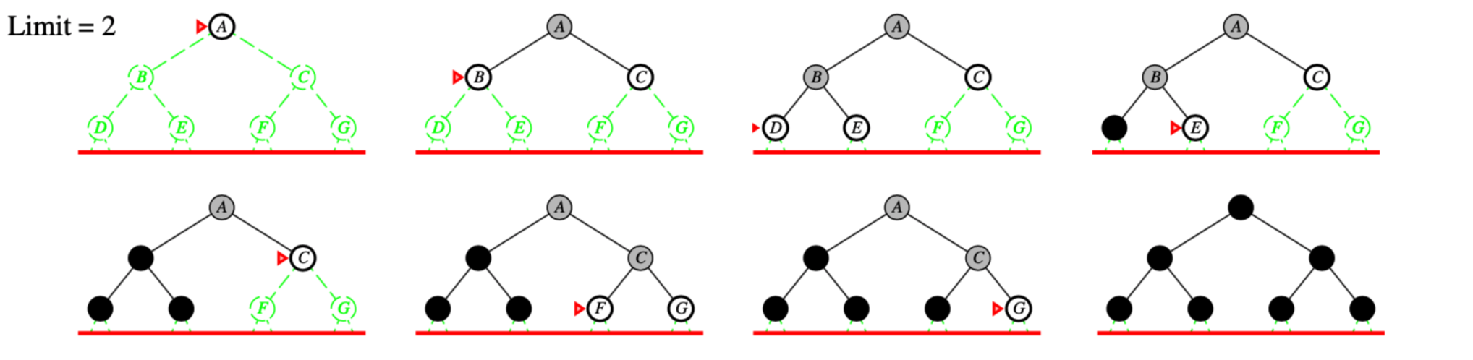
Iterative deepening search

Slide 27
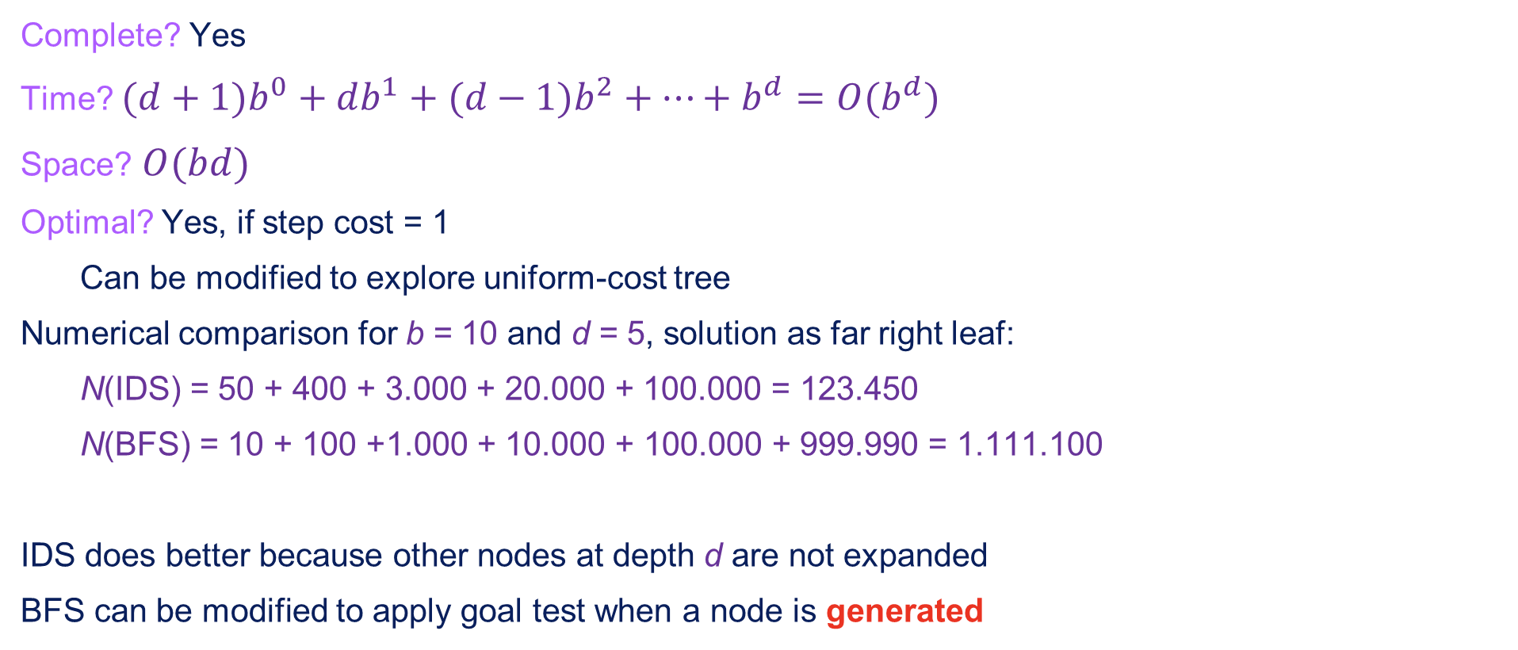
Properties of iterative deepening search
Complete? Yes
Time? $(d+1)b^{0}+db^{1}+(d−1)b^{2}+…+b^{d}=O(b^{d})$
Space? $O(bd)$
Optimal? Yes, if step cost = 1
Can be modified to explore uniform-cost tree
Numerical comparison for b = 10 and d = 5, solution as far right leaf:
N(IDS) = 50 + 400 + 3.000 + 20.000 + 100.000 = 123.450
N(BFS) = 10 + 100 +1.000 + 10.000 + 100.000 + 999.990 = 1.111.100
IDS does better because other nodes at depth d are not expanded
BFS can be modified to apply goal test when a node is generated

Slide 28

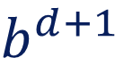


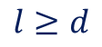
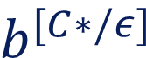

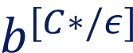



Summary of algorithms
Criterion | Breadth-first | Uniform-Cost | Depth-First | Depth-Limited | Iterative Deepening
Complete? | Yes* | Yes* | No | Yes, if | Yes
Time?
Space?
Optimal? | Yes* | Yes | No | No | Yes*
$$l≥d$$
$$b^{d+1}$$
$$b^{[C∗/ε]}$$
$$b^{m}$$
$$b^{l}$$
$$b^{d}$$
$$b^{d+1}$$
$$b^{[C∗/ε]}$$
$$bm$$
$$bl$$
$$bd$$

Slide 29
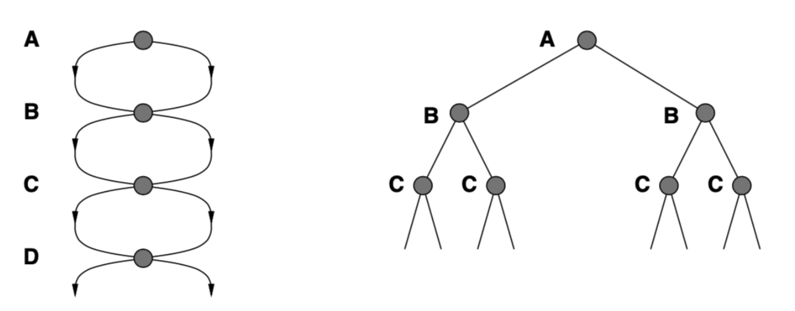
Repeated states
Failure to detect repeated states can turn a linear problem into an exceptional one!

Slide 30
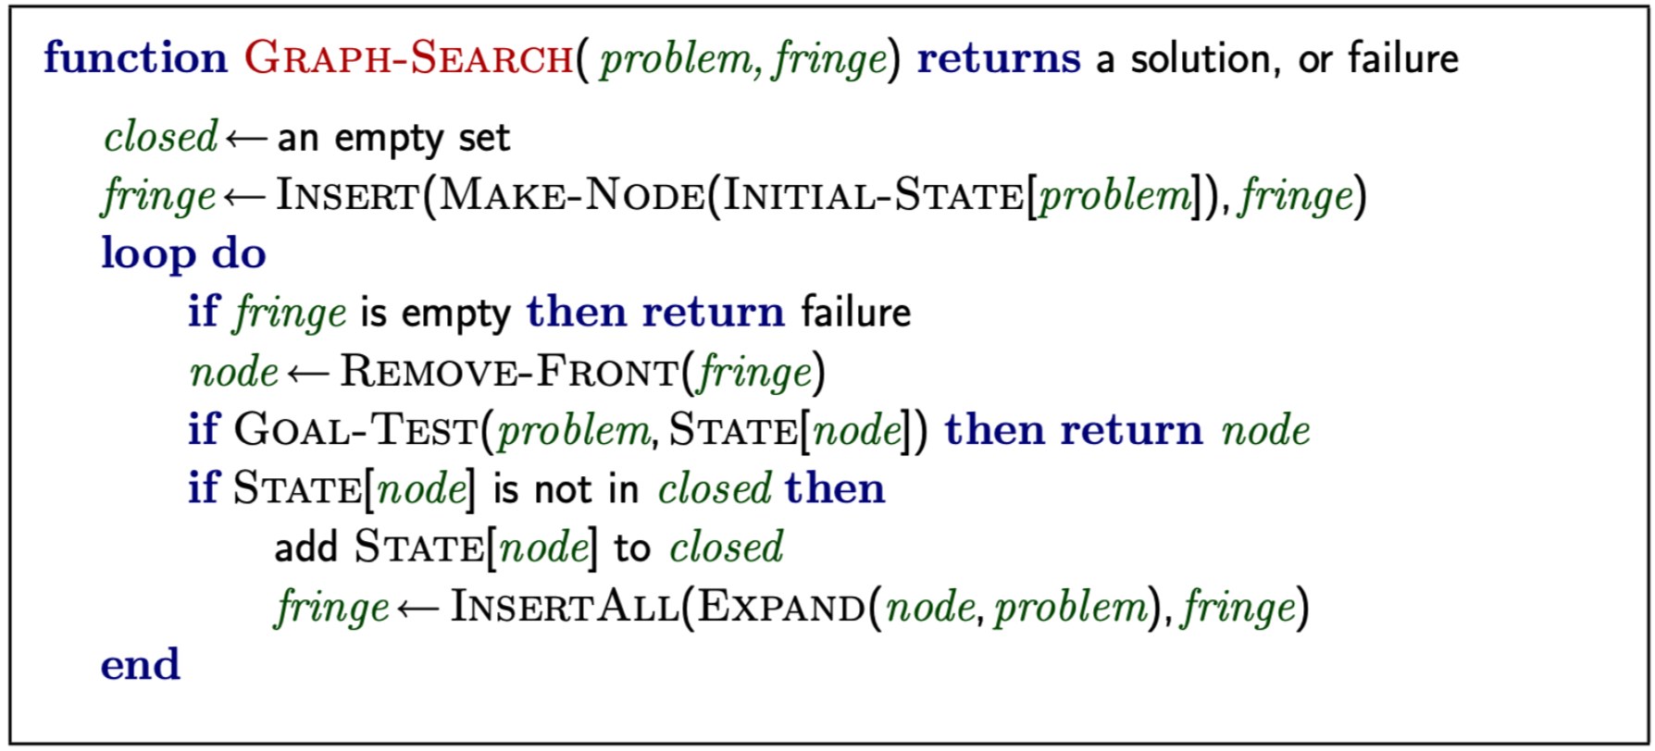
Graph search

Slide 31
Summary
Problem formulation usually requires abstracting away real-world details define a state space that can feasibly be explored
Variety of uninformed search strategies
Iterative deepening search uses only linear space and not much more time than other uniformed algorithms
Graph search can be exponentially more efficient than tree search

